Slide 1
IoT Based Patient Monitoring System and Control
INTERFACING HEART RATE SENSOR WITH BEAGLEBONE BLACK
Submitted By,
Bibin Babu C0749104
Group 2

Slide 2
Contents:
Introduction
Interfacing BeagleBone with AD8232
Connection Details
Coding Steps
Output
Reference

Slide 3
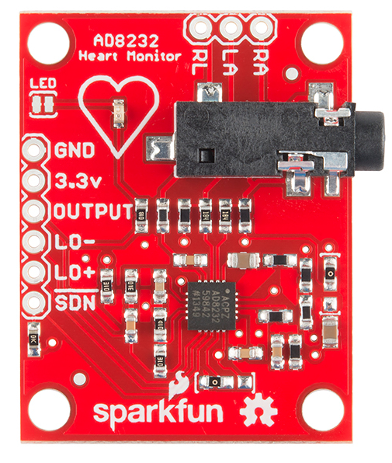
Introduction:
AD8232 is a little chip used to measure the electric activity of the heart.
This is a 6 pin board which is having GND, VCC, Output, LO-, LO+ and SDN which is Shutdown pin and is not used.
The Output is an analog data and which is converted to corresponding BPM.
In this project the function of AD8232 is to continuously monitor the patient heart beat.

Slide 4
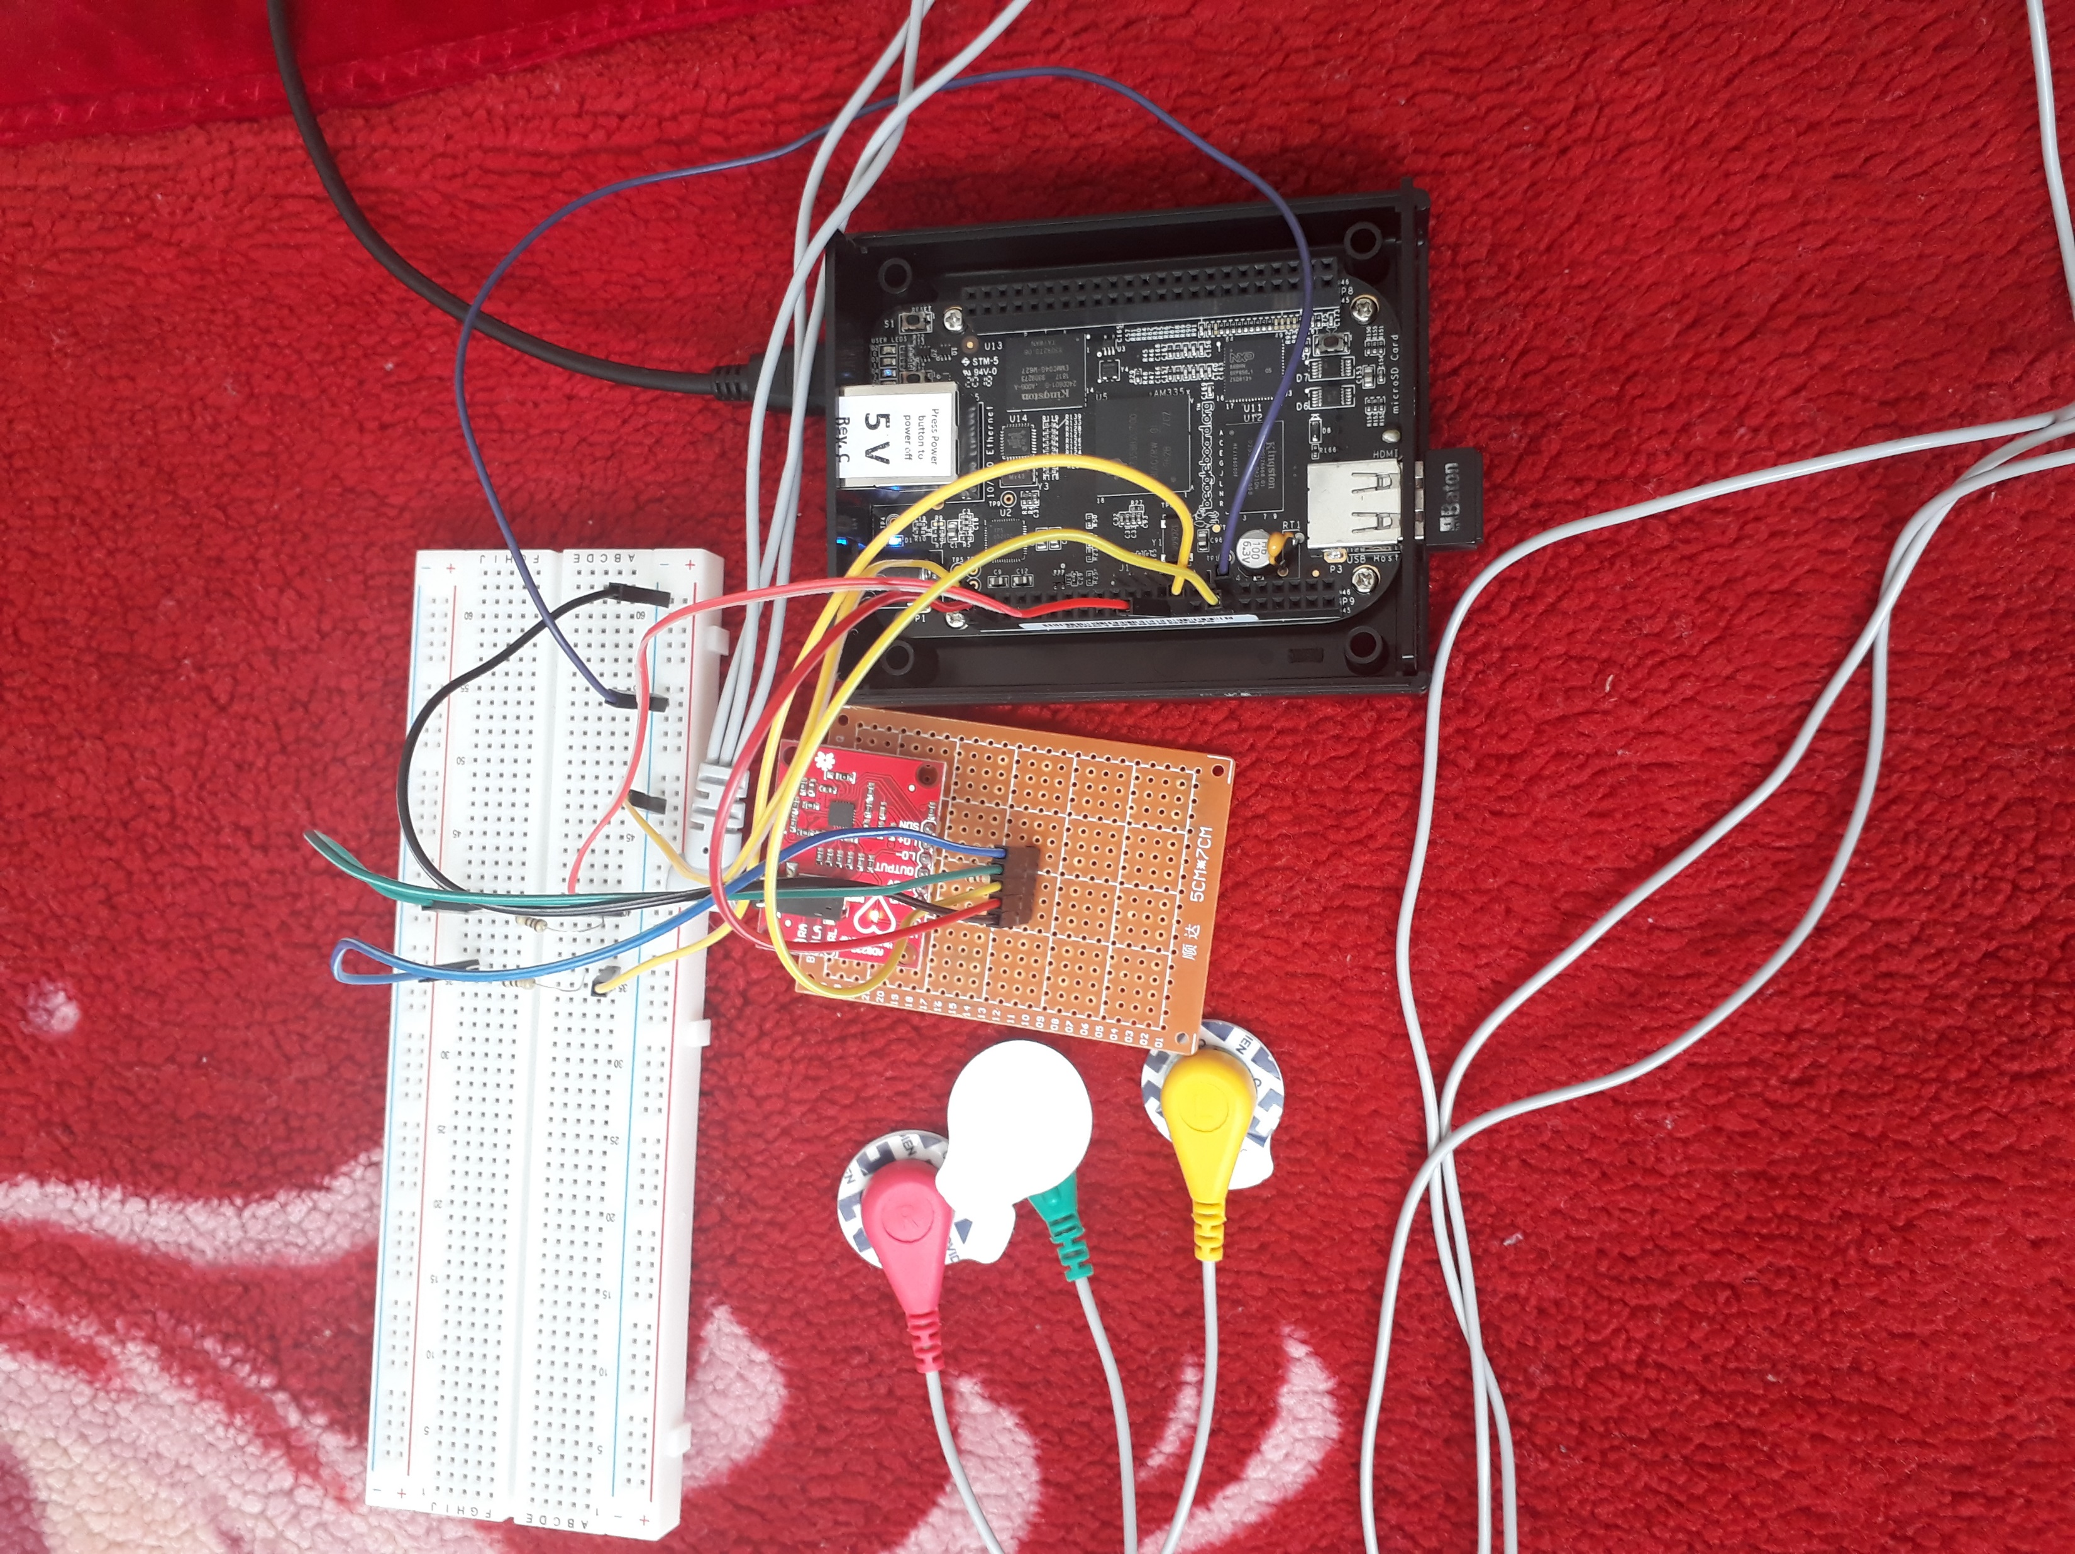
Interfacing BeagleBone with AD8232:
The operating voltage of the board and BeagleBone 3.3V so we can directly connect the VCC.
The analog out from the output pin goes up to a maximum of 2 to 2.5 V and the analog out of BeagleBone is 1.8V.
In order to protect the BeagleBone I have used a 1K resistance in series.

Slide 5
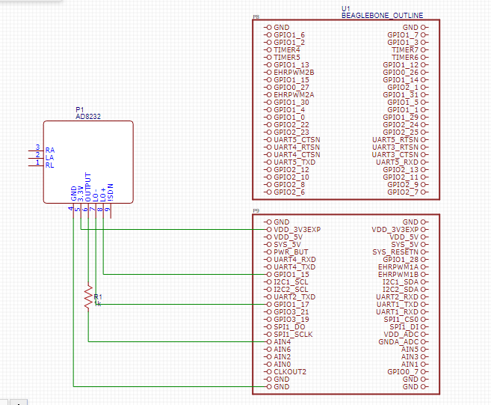

Connection Details:
This sensor output is connected to the Analog pin (AIN 4) via 1 K resistor.
VDD 3.3V
GND GND
Lead off Detection pins are connected to GPIO1_17 and GPIO3_19.

Slide 6
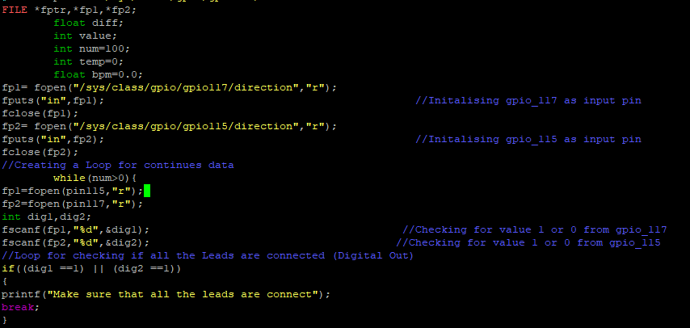
Coding Steps:
Defining the GPIO pins for digital and setting the direction as read and adding “in” using fputs.
Reading the value from GPIO as 1 or 0.
Loop in order to make sure that all the Leads are connected.

Slide 7

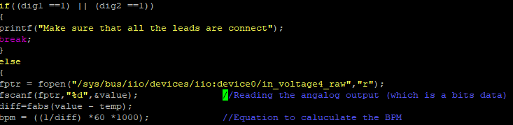
Contd.
Setting the analog pin direction as read if the GPIO values are low(0).
Comparing the value obtained in different time period and taking the difference.
Calculating the BPM Beats per minute
BPM = (1/Time period)* 60 *1000

Slide 8
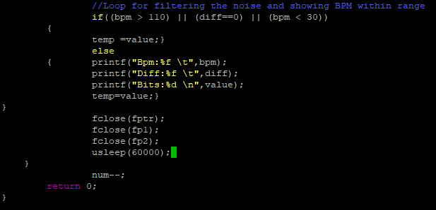
Contd.
Due to analog out there is chance of noise which a result in sudden spike in the BPM.
The loop is used to provide a certain threshold limit.
Num is defined in order to set the count to the while loop.

Slide 9
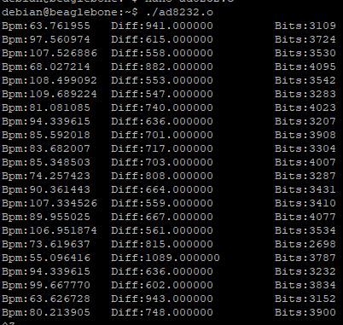
Output:

Slide 10
Reference:
AD8232 Heart Rate Monitor Hookup Guide, (N.D), CASEYTHEROBOT
https://learn.sparkfun.com/tutorials/ad8232-heart-rate-monitor-hookup-guide/all#:~:text=The%20AD8232%20is%20a%20neat,help%20diagnose%20various%20heart%20conditions.
The BeagleBone Black Primer, October 2015, Brian McLaughlin
https://books.google.ca/books?id=W2OkCgAAQBAJ&pg=PT189&lpg=PT189&dq=sen-11574+pulse+sensor+interface+with+beaglebone+black&source=bl&ots=_ixIVCSr5g&sig=ACfU3U2FI8b0R1r4xkdNBNavN4FY-w1zeQ&hl=en&sa=X&ved=2ahUKEwihh9WLn6fqAhXtUd8KHX5CA1gQ6AEwAHoECAgQAQ#v=onepage&q=sen-11574%20pulse%20sensor%20interface%20with%20beaglebone%20black&f=false
Exploring BeagleBone, (N,D), Derek Molloy

